Slide 1
INTRODUCTION TO COMPUTING
Course Code: CCINCOM/L
Exploration and Exploitation, Multi-Arm Bandits
Elizer Ponio Jr.
Faculty Member
Department of Computer Science
College of Computing and Information Technologies (CCIT)
National University
Joseph Marvin R. Imperial
REINFORCEMENT LEARNING
NU College of Computing and Information Technologies
Course Code: CCRNFLRL

Slide 2
Major Components of an RL Agent
INTRODUCTION TO COMPUTING
Course Code: CCINCOM/L
How can the RL agent learn?
An RL agent may include one or more of these components:
Policy - agent’s behavior function or strategy .
Value function - how good is each state and/or action .
Model - agent’s representation of the environment. Optional.
Review in Probability, Intro to RL Concepts
Joseph Marvin R. Imperial
REINFORCEMENT LEARNING
NU College of Computing and Information Technologies
Course Code: CCRNFLRL

Slide 3
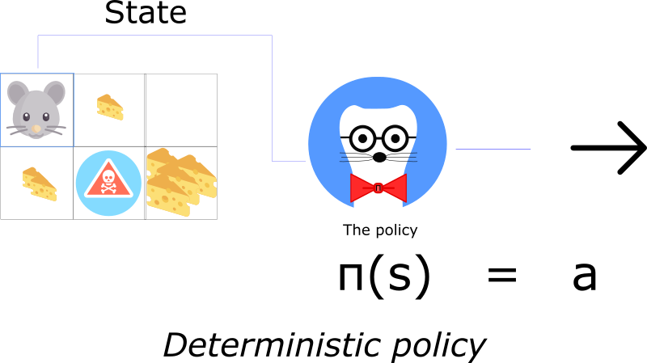
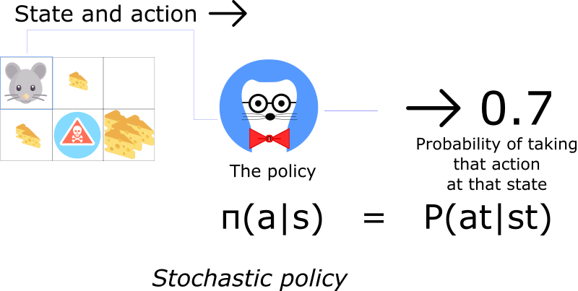

Policy $π$
INTRODUCTION TO COMPUTING
Course Code: CCINCOM/L
Review in Probability, Intro to RL Concepts
Joseph Marvin R. Imperial
REINFORCEMENT LEARNING
NU College of Computing and Information Technologies
Course Code: CCRNFLRL

Slide 4
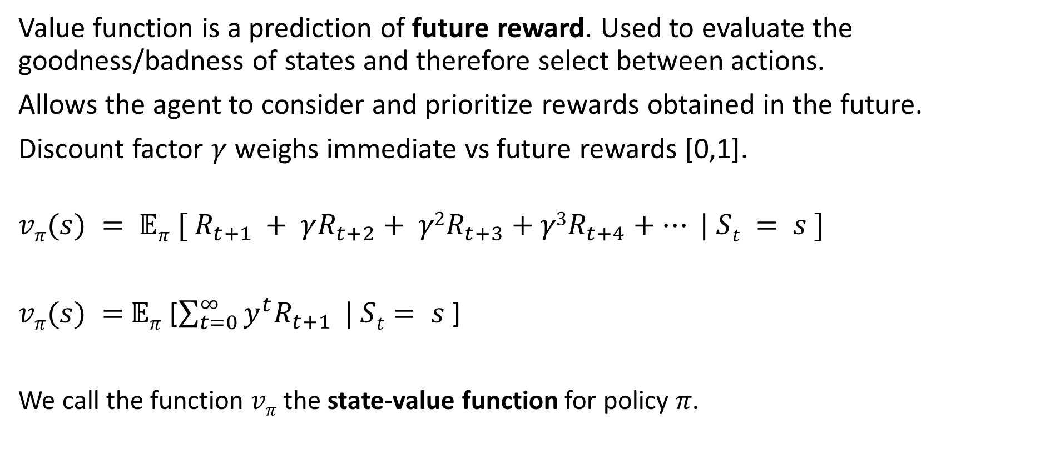
Value Function
INTRODUCTION TO COMPUTING
Course Code: CCINCOM/L
Value function is a prediction of future reward. Used to evaluate the goodness/badness of states and therefore select between actions.
Allows the agent to consider and prioritize rewards obtained in the future.
Discount factor $γ$ weighs immediate vs future rewards [0,1].
$$vπ(s) = 𝔼π [ R_{t+1} + γR_{t+2}+ γ2R_{t+3}+γ3R_{t+4}+… | St = s ]$$
$vπ(s) =$ $𝔼π$ [$\sum_{t=0}^{∞}{y^{t}R_{t+1}} | St= s$]
We call the function $vπ$ the state-value function for policy 𝜋.
Review in Probability, Intro to RL Concepts
Joseph Marvin R. Imperial
REINFORCEMENT LEARNING
NU College of Computing and Information Technologies
Course Code: CCRNFLRL

Slide 5

Value Function
INTRODUCTION TO COMPUTING
Course Code: CCINCOM/L
The value functions and can be estimated from experience.
For example, if an agent follows policy and maintains an average $𝔼π$ for each state encountered, of the actual returns $Gt$ that have followed that state, then the average will converge to the state's value $vπ(s)$ as the number of times that state is encountered approaches infinity.
Review in Probability, Intro to RL Concepts
Joseph Marvin R. Imperial
REINFORCEMENT LEARNING
NU College of Computing and Information Technologies
Course Code: CCRNFLRL

Slide 6
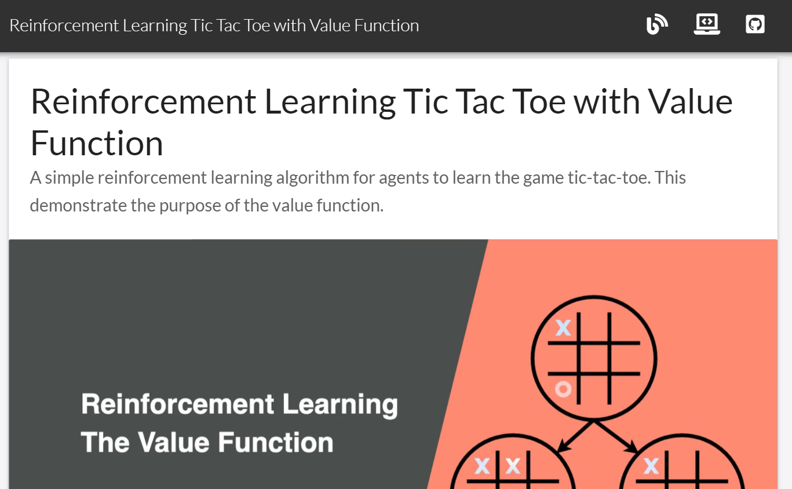
Value Function – Tic Tac Toe
INTRODUCTION TO COMPUTING
Course Code: CCINCOM/L
https://jinglescode.github.io/reinforcement-learning-tic-tac-toe/
Review in Probability, Intro to RL Concepts
Joseph Marvin R. Imperial
REINFORCEMENT LEARNING
NU College of Computing and Information Technologies
Course Code: CCRNFLRL

Slide 7

Model
INTRODUCTION TO COMPUTING
Course Code: CCINCOM/L
Agent’s representation of how world changes given agent’s action. $P$ predicts the next state $R$ predicts the next (immediate) reward.
$$P= ℙ\left[S_{t+1}=s^{′} \right|S_{t}=s, A_{t}=a]$$
$$R= 𝔼\left[R_{t+1}\right|S_{t}=s, A_{t}=a]$$
Review in Probability, Intro to RL Concepts
Joseph Marvin R. Imperial
REINFORCEMENT LEARNING
NU College of Computing and Information Technologies
Course Code: CCRNFLRL

Slide 8
Types of RL Agents
INTRODUCTION TO COMPUTING
Course Code: CCINCOM/L
Value Based
Makes use of the value function to choose action. The goal is to optimize the value function 𝑉(𝑠).
Policy Based
Makes use of optimizing the policy to choose action. The goal is to directly optimize the policy function 𝜋(𝑠) without using a value function.
Actor Critic
Combines both value function and optimized policy.
Review in Probability, Intro to RL Concepts
Joseph Marvin R. Imperial
REINFORCEMENT LEARNING
NU College of Computing and Information Technologies
Course Code: CCRNFLRL

Slide 9
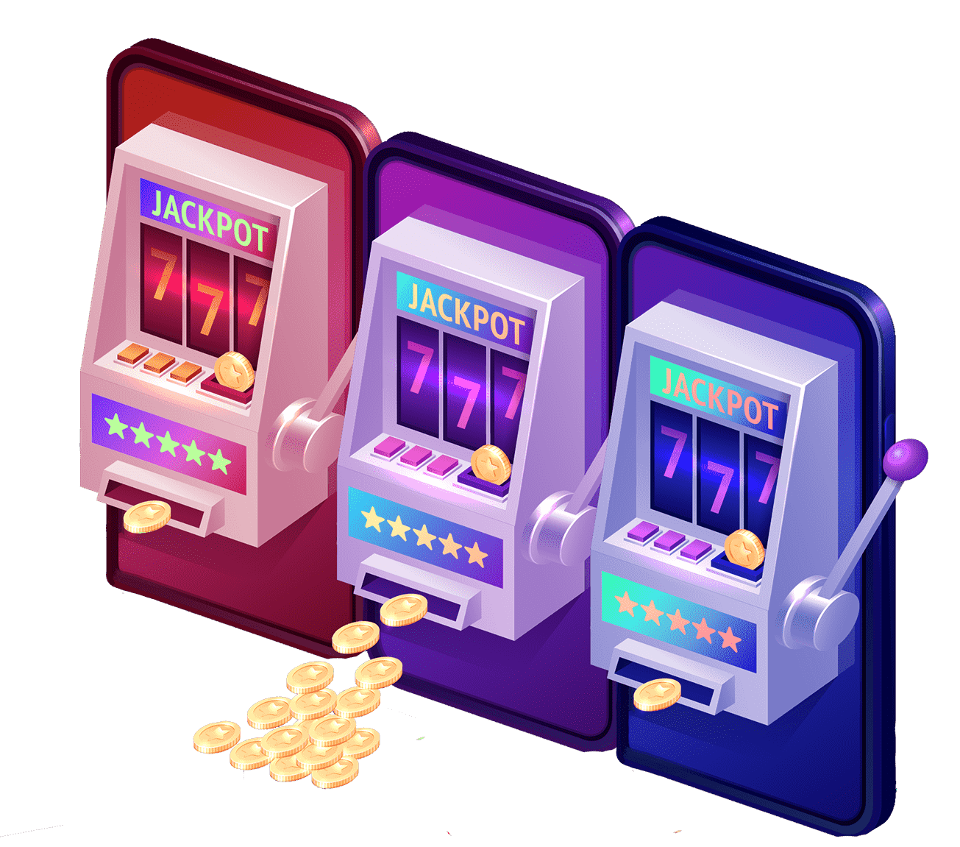
Exploration and Exploitation
INTRODUCTION TO COMPUTING
Course Code: CCINCOM/L
Reinforcement learning is like trial-and-error learning.
The agent should discover a good policy from its experiences of the environment without losing too much reward along the way.
Exploration finds more information about the environment.
Exploitation exploits known information to maximize reward.
It is usually important to explore as well as exploit.
Review in Probability, Intro to RL Concepts
Joseph Marvin R. Imperial
REINFORCEMENT LEARNING
NU College of Computing and Information Technologies
Course Code: CCRNFLRL

Slide 10

Try new foods or stick with your usual?
INTRODUCTION TO COMPUTING
Course Code: CCINCOM/L
Review in Probability, Intro to RL Concepts
A real-life example of the exploration vs exploitation dilemma: where to eat?
Joseph Marvin R. Imperial
REINFORCEMENT LEARNING
NU College of Computing and Information Technologies
Course Code: CCRNFLRL

Slide 11
Exploration and Exploitation
INTRODUCTION TO COMPUTING
Course Code: CCINCOM/L
Restaurant Selection
Exploitation Go to your favorite restaurant.
Exploration Try a new restaurant.
Online Banner Advertisements
Exploitation Show the most successful advert.
Exploration Show a different advert.
Oil Drilling
Exploitation Drill at the best known location.
Exploration Drill at a new location.
Game Playing
Exploitation Play the move you believe is best.
Exploration Play an experimental move.
Review in Probability, Intro to RL Concepts
Joseph Marvin R. Imperial
REINFORCEMENT LEARNING
NU College of Computing and Information Technologies
Course Code: CCRNFLRL

Slide 12
Exploration and Exploitation
INTRODUCTION TO COMPUTING
Course Code: CCINCOM/L
The dilemma comes from the incomplete information: we need to gather enough information to make best overall decisions while keeping the risk under control.
With exploitation, we take advantage of the best option we know. With exploration, we take some risk to collect information about unknown options.
Challenges:
The best long-term strategy may involve short-term sacrifices.
Gather enough information to make the best overall decisions.
Review in Probability, Intro to RL Concepts
Joseph Marvin R. Imperial
REINFORCEMENT LEARNING
NU College of Computing and Information Technologies
Course Code: CCRNFLRL

Slide 13
Principles in Exploration vs. Exploitation
INTRODUCTION TO COMPUTING
Course Code: CCINCOM/L
Naive Exploration
Add noise to greedy policy (e.g. ɛ-greedy)
Optimistic Initialization
Assume the best until proven otherwise
Optimism in the Face of Uncertainty
Prefer actions with uncertain values
Review in Probability, Intro to RL Concepts
Joseph Marvin R. Imperial
REINFORCEMENT LEARNING
NU College of Computing and Information Technologies
Course Code: CCRNFLRL

Slide 14
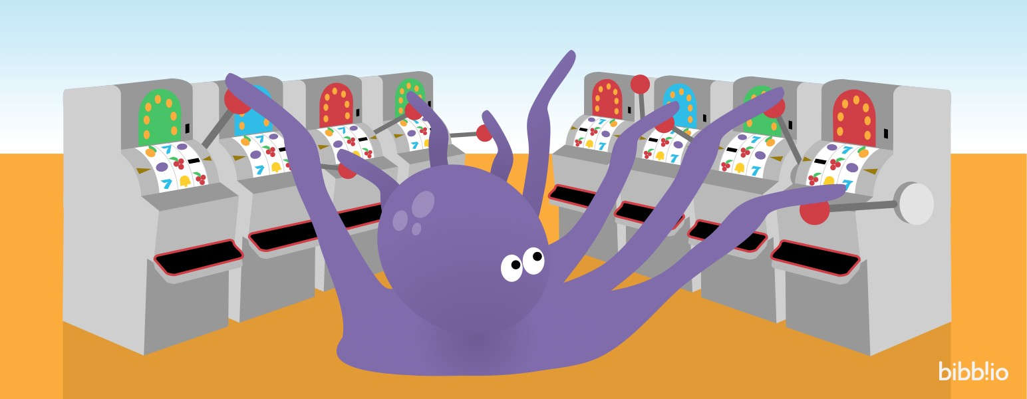
Multi-Arm Bandits
INTRODUCTION TO COMPUTING
Course Code: CCINCOM/L
The multi-armed bandit problem (k-arm) is a classic problem that well demonstrates the exploration vs. exploitation dilemma.
Imagine you are in a casino facing multiple slot machines and each is configured with an unknown probability of how likely you can get a reward at one play.
The question is: What is the best strategy to achieve highest long-term rewards?
Review in Probability, Intro to RL Concepts
Joseph Marvin R. Imperial
REINFORCEMENT LEARNING
NU College of Computing and Information Technologies
Course Code: CCRNFLRL

Slide 15
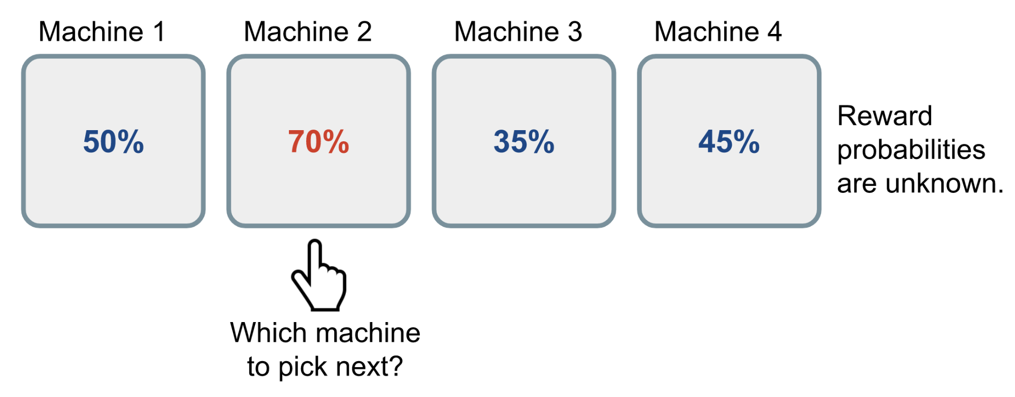
Multi-Arm Bandits
INTRODUCTION TO COMPUTING
Course Code: CCINCOM/L
Review in Probability, Intro to RL Concepts
A naive approach can be that you continue to playing with one machine for many many rounds so as to eventually estimate the “true” reward probability according to the law of large numbers. However, this is quite wasteful and surely does not guarantee the best long-term reward.
Joseph Marvin R. Imperial
REINFORCEMENT LEARNING
NU College of Computing and Information Technologies
Course Code: CCRNFLRL

Slide 16
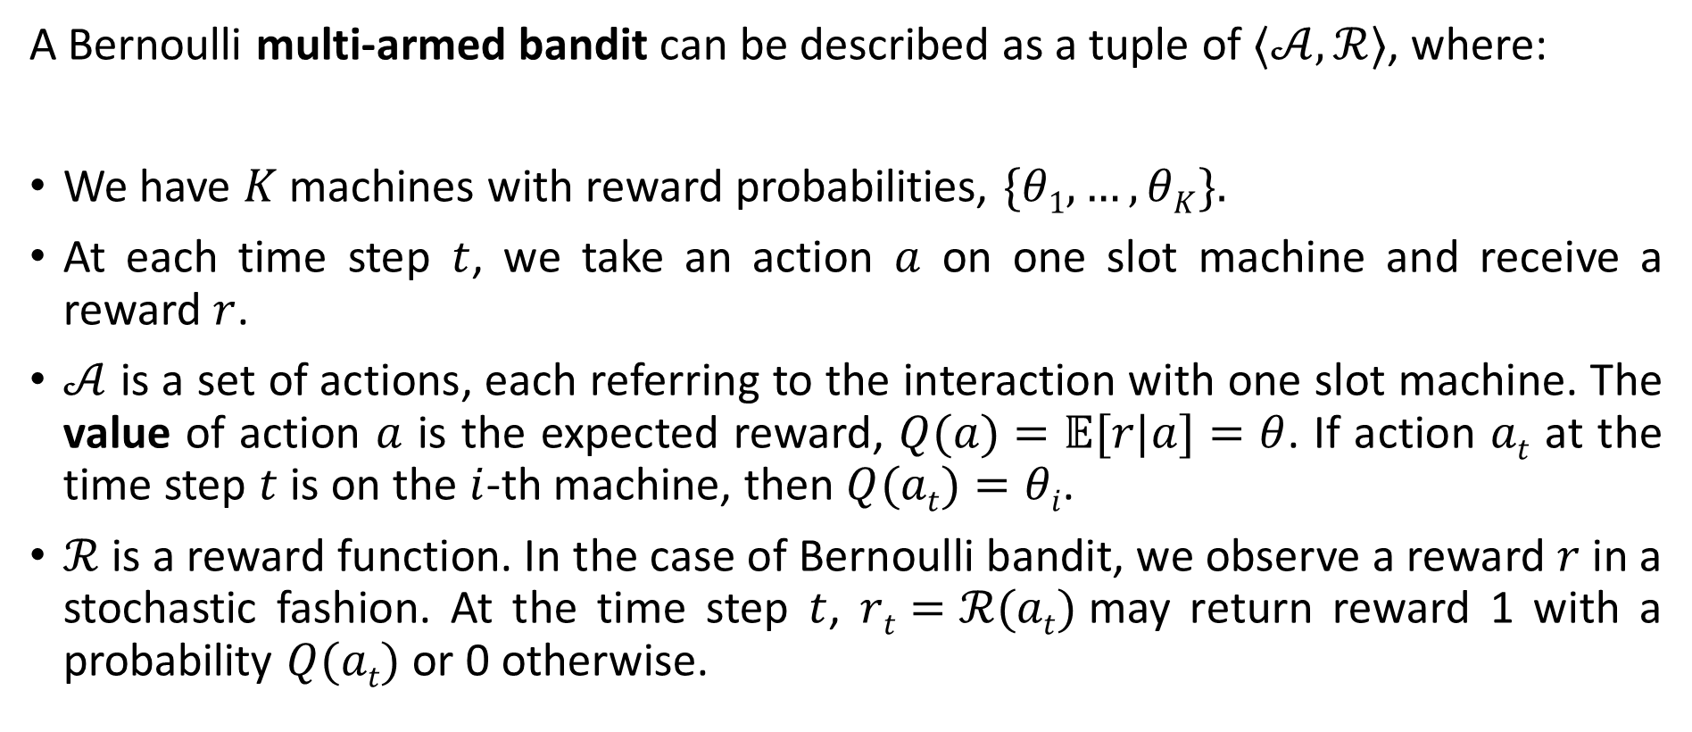
Multi-Arm Bandits (Formal)
INTRODUCTION TO COMPUTING
Course Code: CCINCOM/L
A Bernoulli multi-armed bandit can be described as a tuple of $⟨𝒜,ℛ⟩$, where:
We have $K$ machines with reward probabilities, $\{θ1,…,θK\}.$
At each time step $t$, we take an action $a$ on one slot machine and receive a reward $r$.
$𝒜$ is a set of actions, each referring to the interaction with one slot machine. The value of action $a$ is the expected reward, $Q(a)=𝔼[r|a]=θ$. If action $at$ at the time step $t$ is on the $i$-th machine, then $Q(at)=θi$.
$ℛ$ is a reward function. In the case of Bernoulli bandit, we observe a reward $r$ in a stochastic fashion. At the time step $t$, $rt=ℛ(at)$may return reward 1 with a probability $Q(at)$or 0 otherwise.
Review in Probability, Intro to RL Concepts
Joseph Marvin R. Imperial
REINFORCEMENT LEARNING
NU College of Computing and Information Technologies
Course Code: CCRNFLRL

Slide 17
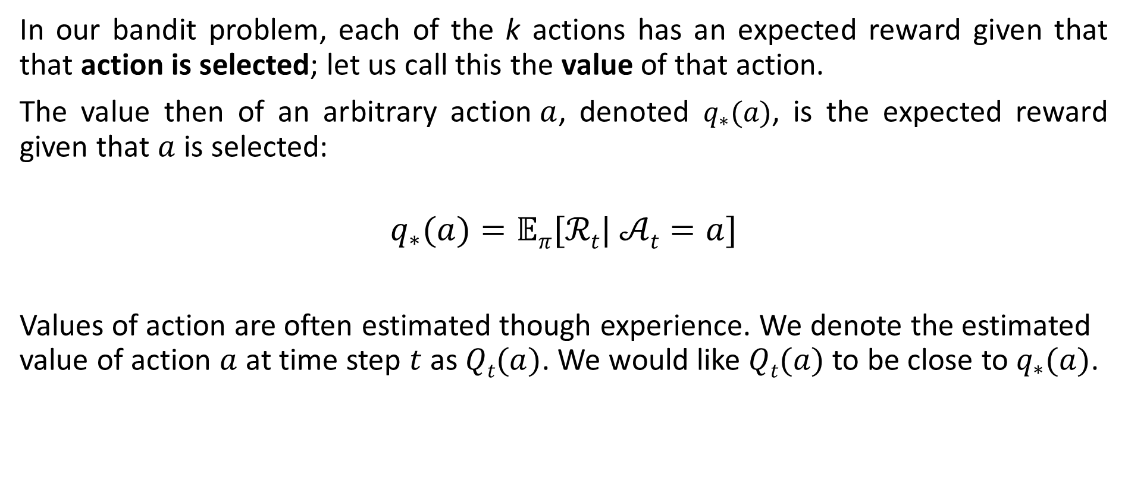

Action-Value Function $Q(a)$
INTRODUCTION TO COMPUTING
Course Code: CCINCOM/L
In our bandit problem, each of the k actions has an expected reward given that that action is selected; let us call this the value of that action.
The value then of an arbitrary action$a$, denoted $q_{∗}(a)$, is the expected reward given that $a$ is selected:
$$q_{∗}(a)=𝔼π[ℛt| 𝒜t=a]$$
Values of action are often estimated though experience. We denote the estimated value of action $a$ at time step $t$ as $Qt(a)$. We would like $Qt(a)$ to be close to $q_{∗}(a)$.
Review in Probability, Intro to RL Concepts
Joseph Marvin R. Imperial
REINFORCEMENT LEARNING
NU College of Computing and Information Technologies
Course Code: CCRNFLRL

Slide 18
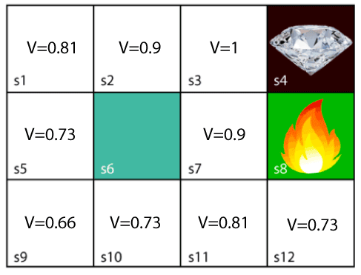
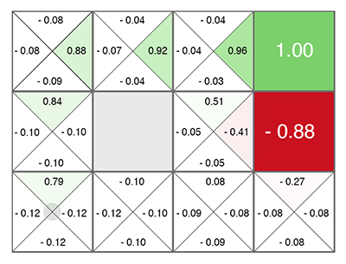
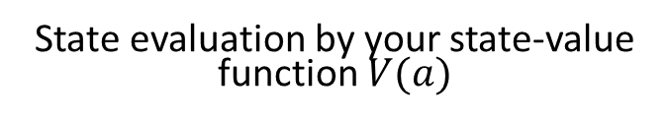
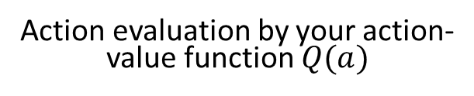
Action-Value Function $Q(a)$
INTRODUCTION TO COMPUTING
Course Code: CCINCOM/L
Review in Probability, Intro to RL Concepts
State evaluation by your state-value function $V(a)$
Action evaluation by your action-value function $Q(a)$
Joseph Marvin R. Imperial
REINFORCEMENT LEARNING
NU College of Computing and Information Technologies
Course Code: CCRNFLRL

Slide 19
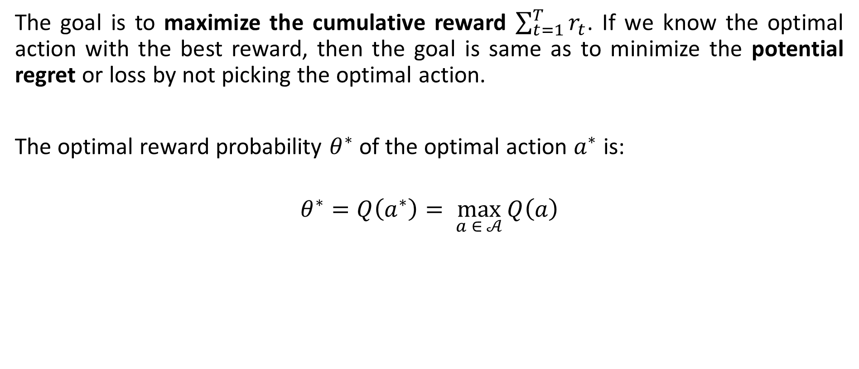
Optimal Reward Probability
INTRODUCTION TO COMPUTING
Course Code: CCINCOM/L
The goal is to maximize the cumulative reward $\sum_{t=1}^{T}{r_{t}}$. If we know the optimal action with the best reward, then the goal is same as to minimize the potential regret or loss by not picking the optimal action.
The optimal reward probability $θ^{∗}$ of the optimal action $a^{∗}$ is:
$$θ^{∗}=Q\left(a^{∗}\right)= \max_{a ∈ 𝒜}{Q\left(a\right)}$$
Review in Probability, Intro to RL Concepts
Joseph Marvin R. Imperial
REINFORCEMENT LEARNING
NU College of Computing and Information Technologies
Course Code: CCRNFLRL

Slide 20
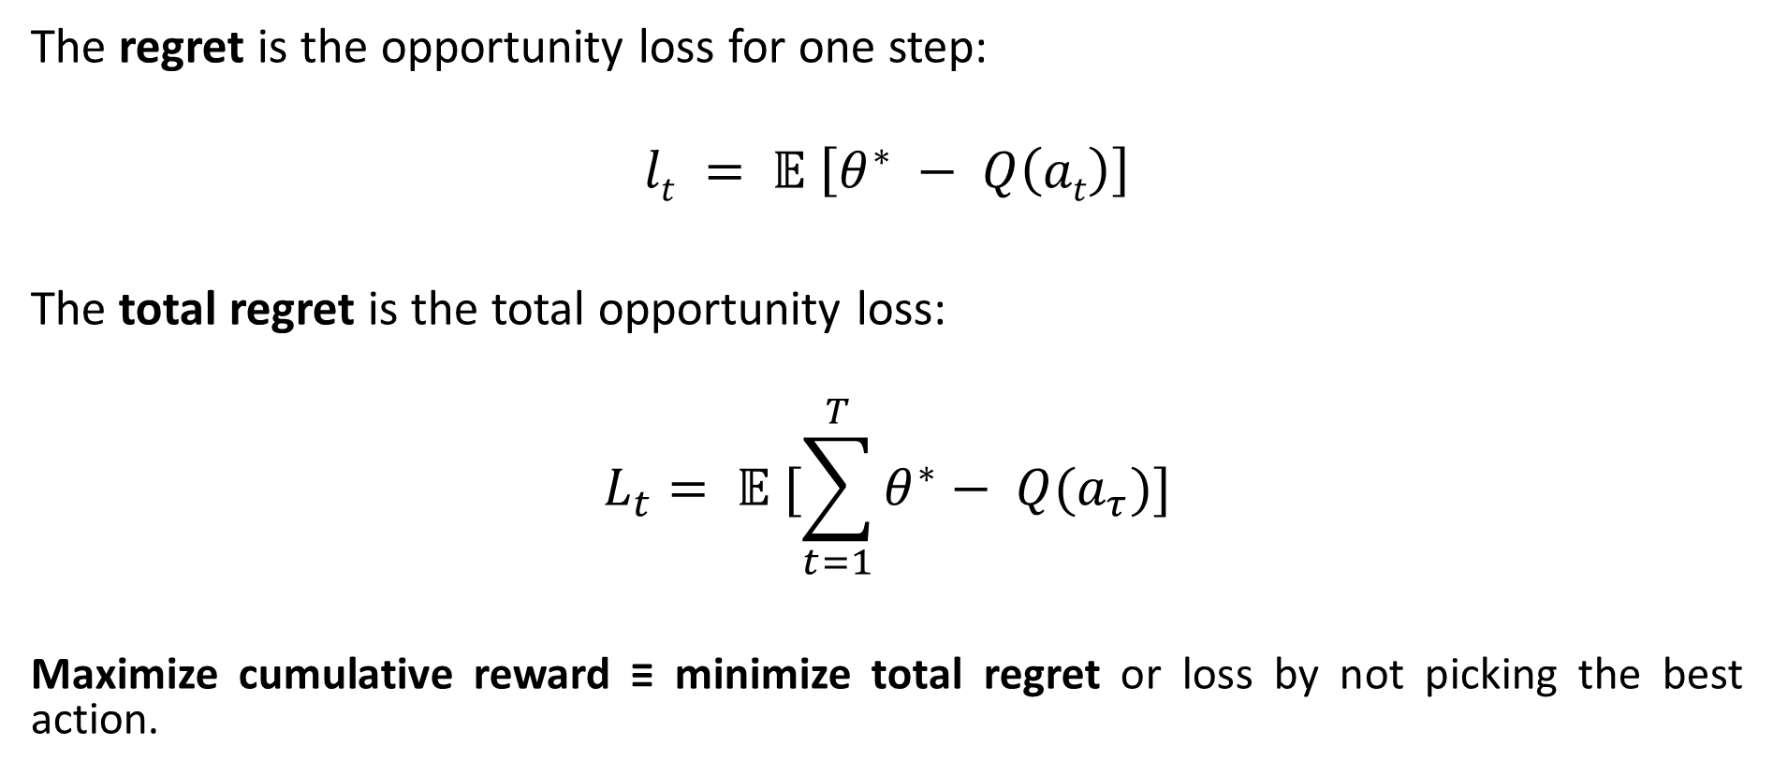
Regret
INTRODUCTION TO COMPUTING
Course Code: CCINCOM/L
The regret is the opportunity loss for one step:
$$lt = 𝔼 \left[θ^{∗} − Q\left(at\right)\right]$$
The total regret is the total opportunity loss:
$$L_{t}= 𝔼 [\sum_{t=1}^{T}{θ^{∗}}− Q(a_{τ})]$$
Maximize cumulative reward ≡ minimize total regret or loss by not picking the best action.
Review in Probability, Intro to RL Concepts
Joseph Marvin R. Imperial
REINFORCEMENT LEARNING
NU College of Computing and Information Technologies
Course Code: CCRNFLRL

Slide 21
Regret
INTRODUCTION TO COMPUTING
Course Code: CCINCOM/L
The action we took
The regret is the opportunity loss for one step:
$$lt = 𝔼 \left[θ^{∗} − Q\left(at\right)\right]$$
The total regret is the total opportunity loss:
$$L_{t}= 𝔼 [\sum_{t=1}^{T}{θ^{∗}}− Q(a_{τ})]$$
Maximize cumulative reward ≡ minimize total regret or loss by not picking the best action.
Review in Probability, Intro to RL Concepts
The best action
Joseph Marvin R. Imperial
REINFORCEMENT LEARNING
NU College of Computing and Information Technologies
Course Code: CCRNFLRL

Slide 22
Bandit Strategies / Policies
INTRODUCTION TO COMPUTING
Course Code: CCINCOM/L
Based on how we do exploration, there several ways to solve the multi-armed bandit.
No exploration. The most naive approach and a bad one.
Exploration at random
Exploration smartly with preference to uncertainty
Review in Probability, Intro to RL Concepts
Joseph Marvin R. Imperial
REINFORCEMENT LEARNING
NU College of Computing and Information Technologies
Course Code: CCRNFLRL

Slide 23
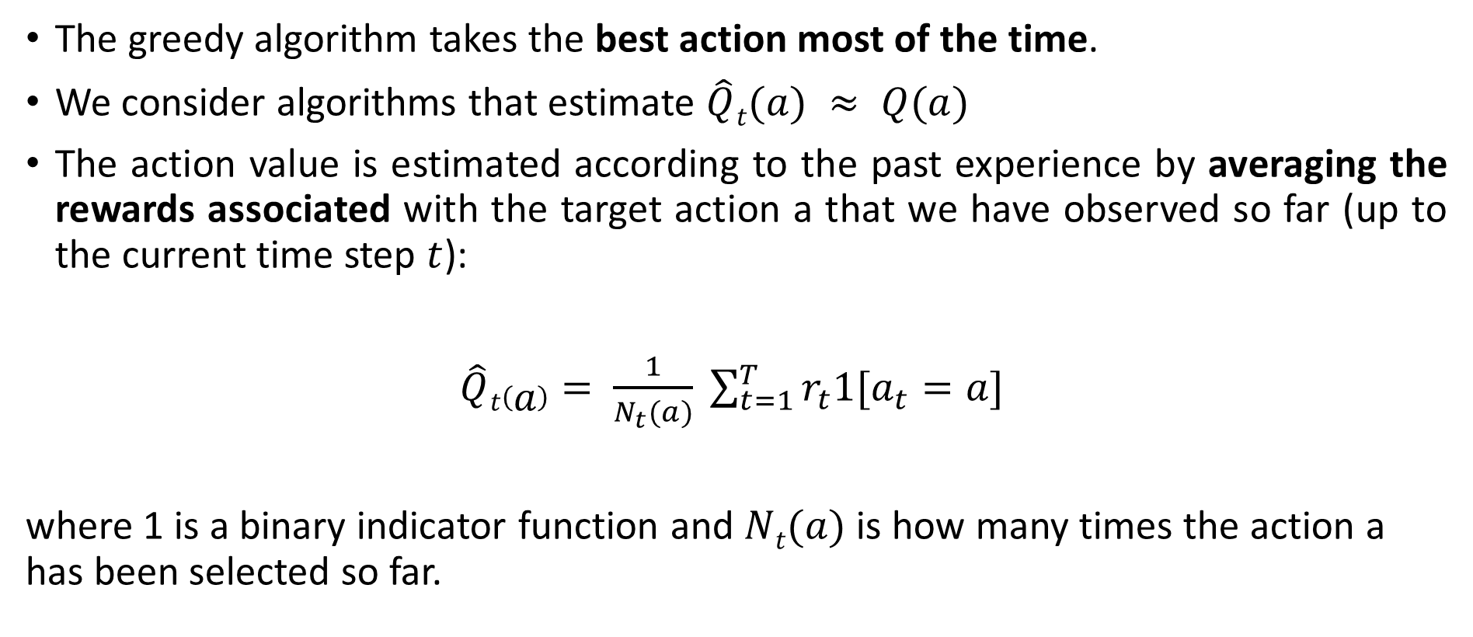
Greedy Algorithm
INTRODUCTION TO COMPUTING
Course Code: CCINCOM/L
The greedy algorithm takes the best action most of the time.
We consider algorithms that estimate $\hat{Q}t(a) ≈ Q(a)$
The action value is estimated according to the past experience by averaging the rewards associated with the target action a that we have observed so far (up to the current time step $t$):
$\hat{Q}t\left(a\right)= \frac{1}{N_{t}(a)} \sum_{t=1}^{T}{r_{t}1[a_{t}=a]}$
where 1 is a binary indicator function and $Nt(a)$ is how many times the action a has been selected so far.
Review in Probability, Intro to RL Concepts
Joseph Marvin R. Imperial
REINFORCEMENT LEARNING
NU College of Computing and Information Technologies
Course Code: CCRNFLRL

Slide 24

Greedy Algorithm
INTRODUCTION TO COMPUTING
Course Code: CCINCOM/L
The greedy algorithm selects action with highest value
$$a_{t}^{∗}=\max_{a∈𝒜} \hat{Qt}{(a)}$$
Greedy can lock onto a suboptimal action forever. It has a linear total regret.
Review in Probability, Intro to RL Concepts
Joseph Marvin R. Imperial
REINFORCEMENT LEARNING
NU College of Computing and Information Technologies
Course Code: CCRNFLRL

Slide 25
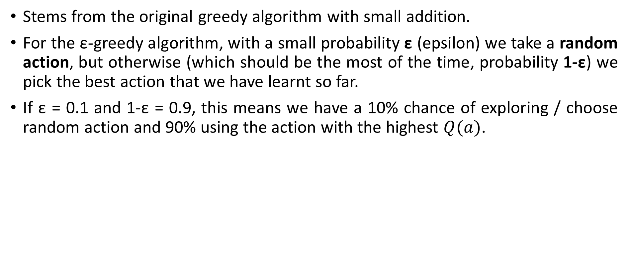
ε- Greedy Algorithm
INTRODUCTION TO COMPUTING
Course Code: CCINCOM/L
Stems from the original greedy algorithm with small addition.
For the ε-greedy algorithm, with a small probability ε (epsilon) we take a random action, but otherwise (which should be the most of the time, probability 1-ε) we pick the best action that we have learnt so far.
If ε = 0.1 and 1-ε = 0.9, this means we have a 10% chance of exploring / choose random action and 90% using the action with the highest $Q(a)$.
Review in Probability, Intro to RL Concepts
Joseph Marvin R. Imperial
REINFORCEMENT LEARNING
NU College of Computing and Information Technologies
Course Code: CCRNFLRL

Slide 26
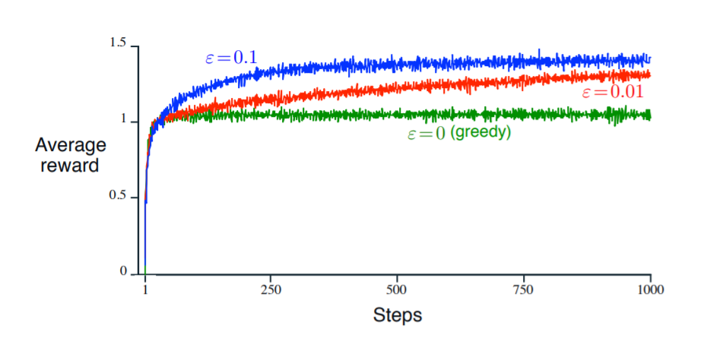
INTRODUCTION TO COMPUTING
Course Code: CCINCOM/L
Average performance of ε-greedy action-value methods on the 10-armed testbed. These data are averages over 2000 runs with different bandit problems. All methods used sample averages as their action-value estimates
Joseph Marvin R. Imperial
REINFORCEMENT LEARNING
NU College of Computing and Information Technologies
Course Code: CCRNFLRL

Slide 27
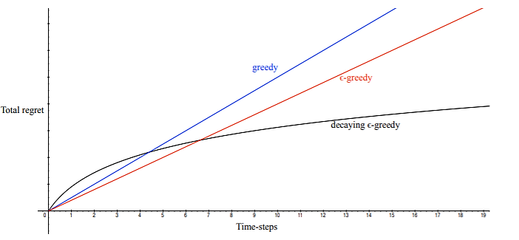
INTRODUCTION TO COMPUTING
Course Code: CCINCOM/L
Review in Probability, Intro to RL Concepts
If an algorithm forever explores it will have linear total regret.
If an algorithm never explores it will have linear total regret.
Is it possible to achieve sublinear total regret?
Joseph Marvin R. Imperial
REINFORCEMENT LEARNING
NU College of Computing and Information Technologies
Course Code: CCRNFLRL

Slide 28
Implementing Greedy and ε- Greedy
INTRODUCTION TO COMPUTING
Course Code: CCINCOM/L
Download the files and try on your own.
Try implementing the full exploration and full exploitation setup. Give your observations
Try changing the # of iterations? Give your observations.
Try changing the ε values [0,1]. What is optimal value of ε?
Review in Probability, Intro to RL Concepts
Joseph Marvin R. Imperial
REINFORCEMENT LEARNING
NU College of Computing and Information Technologies
Course Code: CCRNFLRL

Slide 29
Scenario
INTRODUCTION TO COMPUTING
Course Code: CCINCOM/L
Random exploration gives us an opportunity to try out options that we have not known much about. However, due to the randomness, it is possible we end up exploring a bad action which we have confirmed in the past (bad luck!). It would be better to select among the non-greedy actions according to their potential for actually being optimal.
To avoid such inefficient exploration, possible approaches can be
decrease the parameter ε in time and;
be optimistic about options with high uncertainty to prefer actions for which we haven’t had a confident value estimation yet. Or in other words, we favor exploration of actions with a strong potential to have a optimal value.
Review in Probability, Intro to RL Concepts
Joseph Marvin R. Imperial
REINFORCEMENT LEARNING
NU College of Computing and Information Technologies
Course Code: CCRNFLRL

Slide 30
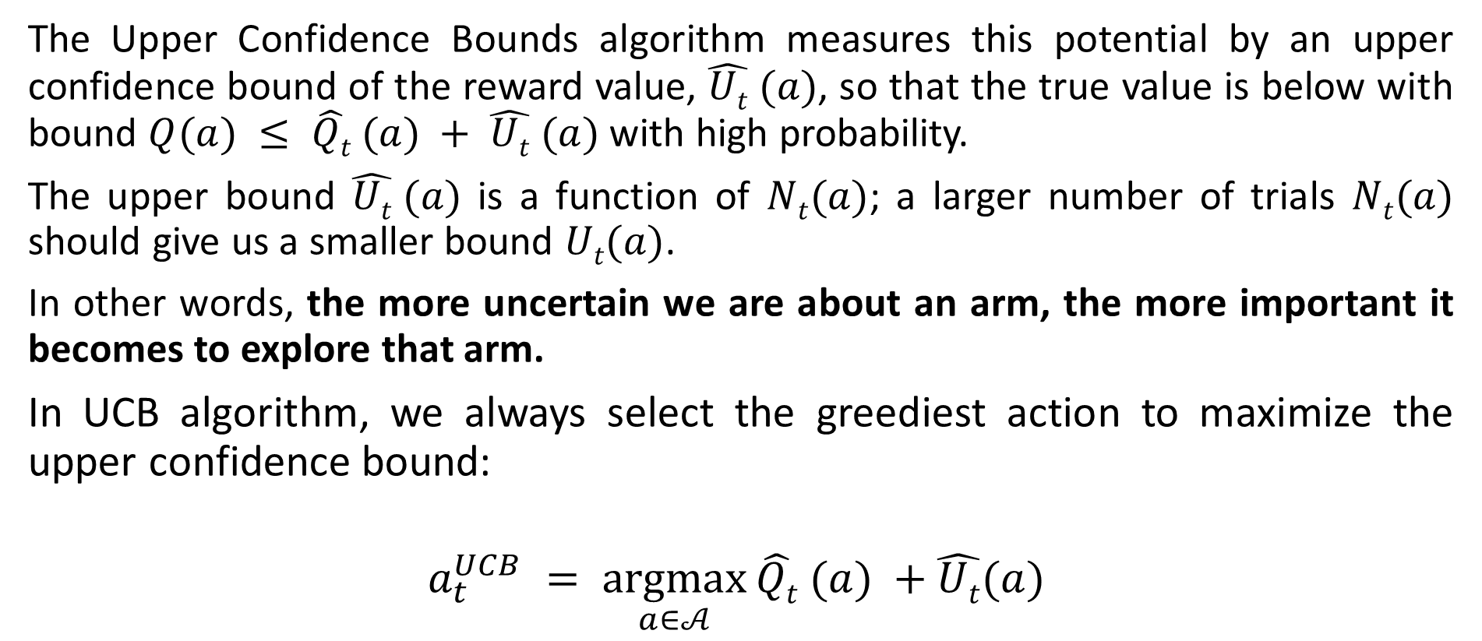
Upper Confidence Bounds (UCB)
INTRODUCTION TO COMPUTING
Course Code: CCINCOM/L
The Upper Confidence Bounds algorithm measures this potential by an upper confidence bound of the reward value, $\hat{Ut} (a)$, so that the true value is below with bound $Q(a) ≤ \hat{Qt} (a) + \hat{Ut} (a)$with high probability.
The upper bound $\hat{Ut} (a)$ is a function of $Nt(a)$; a larger number of trials $Nt(a)$ should give us a smaller bound $Ut(a)$.
In other words, the more uncertain we are about an arm, the more important it becomes to explore that arm.
In UCB algorithm, we always select the greediest action to maximize the upper confidence bound:
$$a_{t}^{UCB} = \underset{a∈𝒜}{argmax}{\hat{Qt} (a) +\hat{Ut}(a) }$$
Review in Probability, Intro to RL Concepts
Joseph Marvin R. Imperial
REINFORCEMENT LEARNING
NU College of Computing and Information Technologies
Course Code: CCRNFLRL

Slide 31
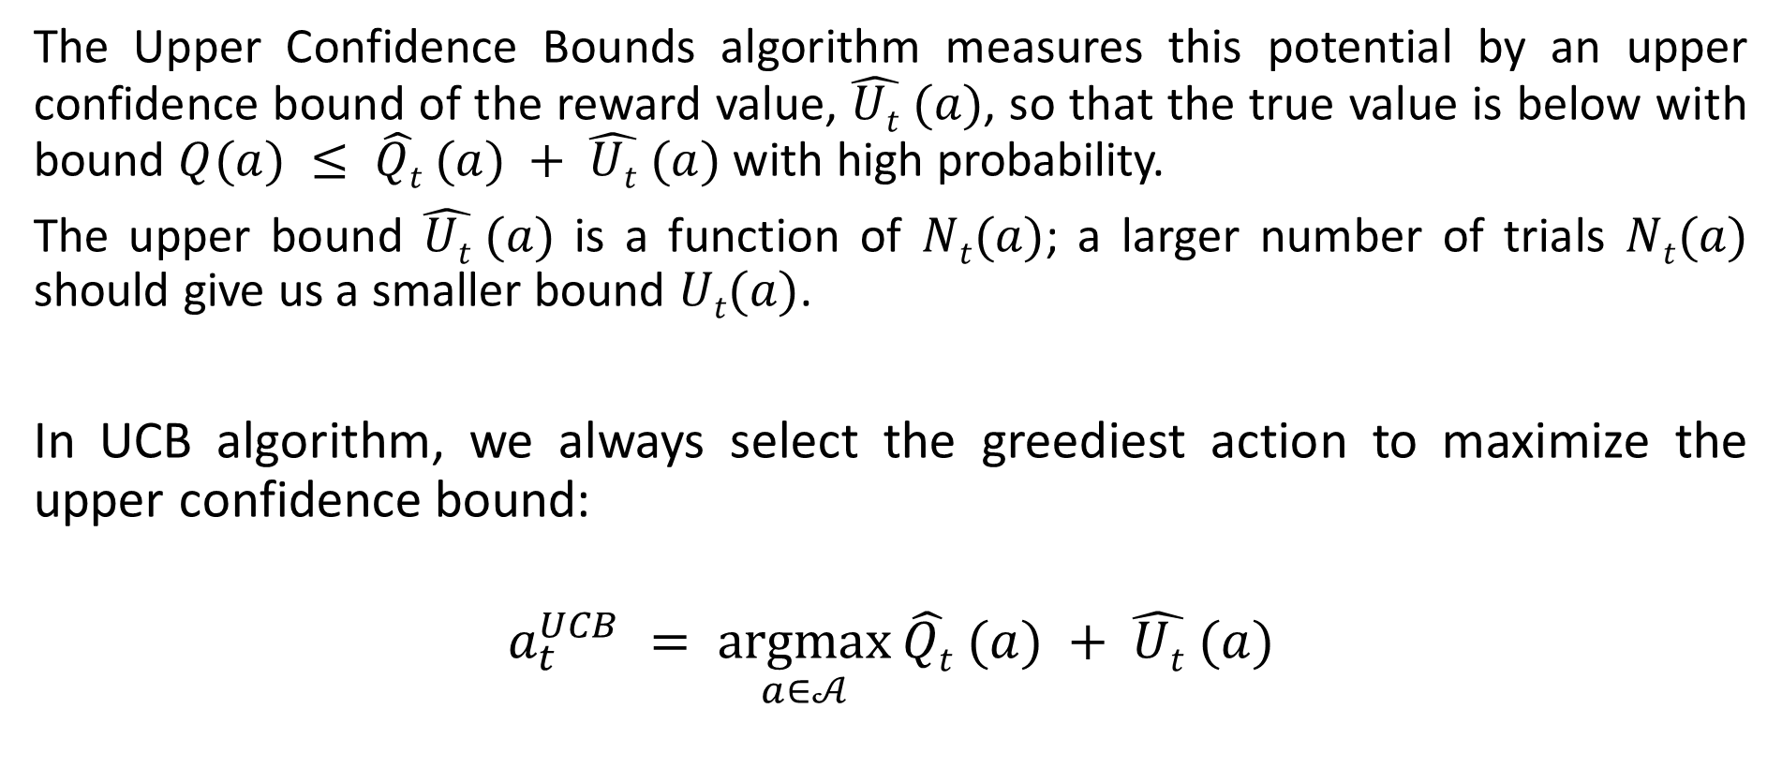
Upper Confidence Bounds (UCB)
INTRODUCTION TO COMPUTING
Course Code: CCINCOM/L
The Upper Confidence Bounds algorithm measures this potential by an upper confidence bound of the reward value, $\hat{Ut} (a)$, so that the true value is below with bound $Q(a) ≤ \hat{Qt} (a) + \hat{Ut} (a)$with high probability.
The upper bound $\hat{Ut} (a)$ is a function of $Nt(a)$; a larger number of trials $Nt(a)$ should give us a smaller bound $Ut(a)$.
In UCB algorithm, we always select the greediest action to maximize the upper confidence bound:
$$a_{t}^{UCB} = \underset{a∈𝒜}{argmax}{\hat{Qt} (a) + \hat{Ut} (a)}$$
Review in Probability, Intro to RL Concepts
Explore
Exploit
Joseph Marvin R. Imperial
REINFORCEMENT LEARNING
NU College of Computing and Information Technologies
Course Code: CCRNFLRL

Slide 32
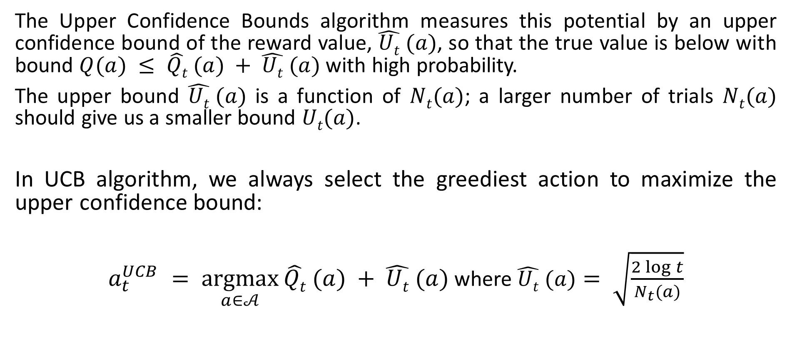
Upper Confidence Bounds (UCB)
INTRODUCTION TO COMPUTING
Course Code: CCINCOM/L
The Upper Confidence Bounds algorithm measures this potential by an upper confidence bound of the reward value, $\hat{Ut} (a)$, so that the true value is below with bound $Q(a) ≤ \hat{Qt} (a) + \hat{Ut} (a)$with high probability.
The upper bound $\hat{Ut} (a)$ is a function of $Nt(a)$; a larger number of trials $Nt(a)$ should give us a smaller bound $Ut(a)$.
In UCB algorithm, we always select the greediest action to maximize the upper confidence bound:
$a_{t}^{UCB} = \underset{a∈𝒜}{argmax}{\hat{Qt} (a) + \hat{Ut} (a)}$ where $\hat{Ut} (a)= \sqrt{\frac{2\log{t}}{N_{t}(a)}}$
Review in Probability, Intro to RL Concepts
Joseph Marvin R. Imperial
REINFORCEMENT LEARNING
NU College of Computing and Information Technologies
Course Code: CCRNFLRL

Slide 33
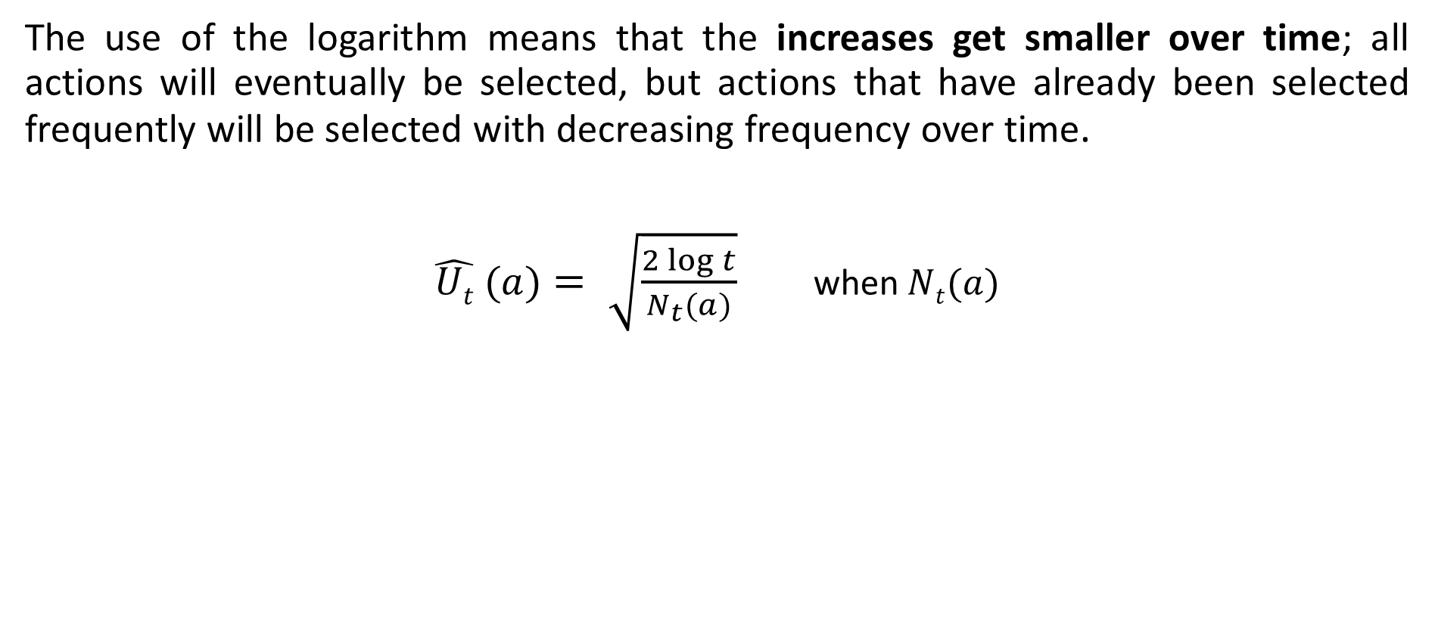
Upper Confidence Bounds (UCB)
INTRODUCTION TO COMPUTING
Course Code: CCINCOM/L
The use of the logarithm means that the increases get smaller over time; all actions will eventually be selected, but actions that have already been selected frequently will be selected with decreasing frequency over time.
$\hat{Ut} (a)= \sqrt{\frac{2\log{t}}{N_{t}(a)}}$ when $Nt(a)$
Review in Probability, Intro to RL Concepts
Joseph Marvin R. Imperial
REINFORCEMENT LEARNING
NU College of Computing and Information Technologies
Course Code: CCRNFLRL

Slide 34
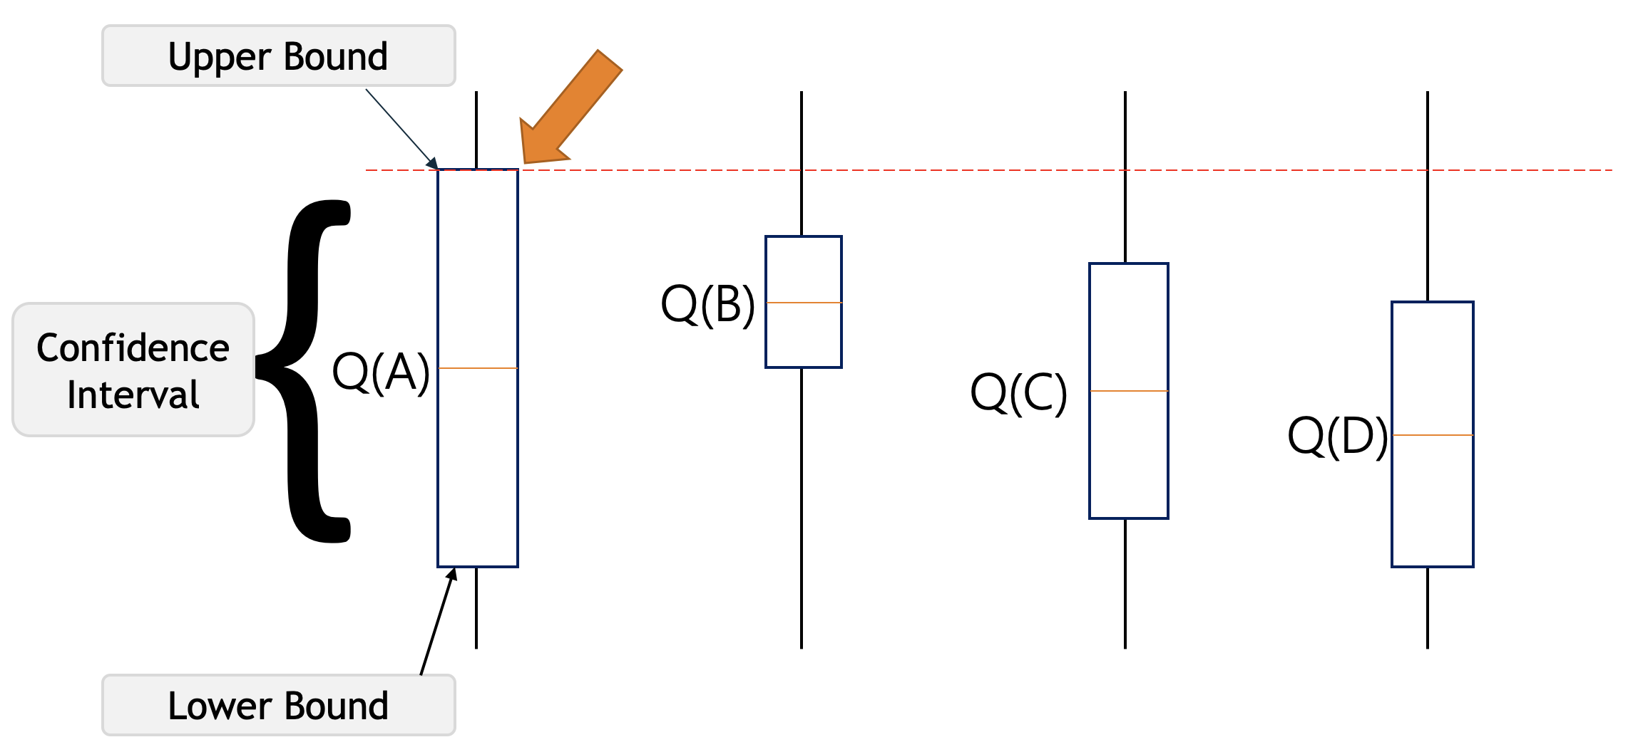
Upper Confidence Bounds (UCB)
INTRODUCTION TO COMPUTING
Course Code: CCINCOM/L
Review in Probability, Intro to RL Concepts
According to the UCB algorithm, it will optimistically pick the action that has the highest upper bound i.e. A or highest uncertainty value.
Joseph Marvin R. Imperial
REINFORCEMENT LEARNING
NU College of Computing and Information Technologies
Course Code: CCRNFLRL

Slide 35
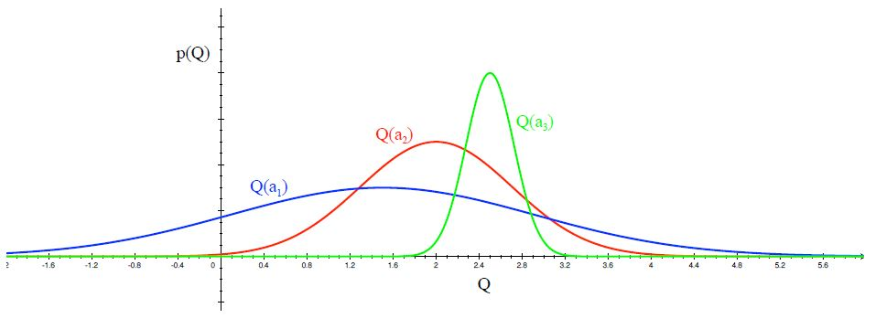
Upper Confidence Bounds (UCB)
INTRODUCTION TO COMPUTING
Course Code: CCINCOM/L
Review in Probability, Intro to RL Concepts
Distribution of action-value functions for 3 different arms $a1, a2$and $a3$ after several trials is shown in the figure above. This distribution shows that the action value for $a1$ has the highest variance and hence maximum uncertainty. UCB says that we should choose the arm $a1$ and receive a reward making us less uncertain about its action-value.
Joseph Marvin R. Imperial
REINFORCEMENT LEARNING
NU College of Computing and Information Technologies
Course Code: CCRNFLRL

Slide 36
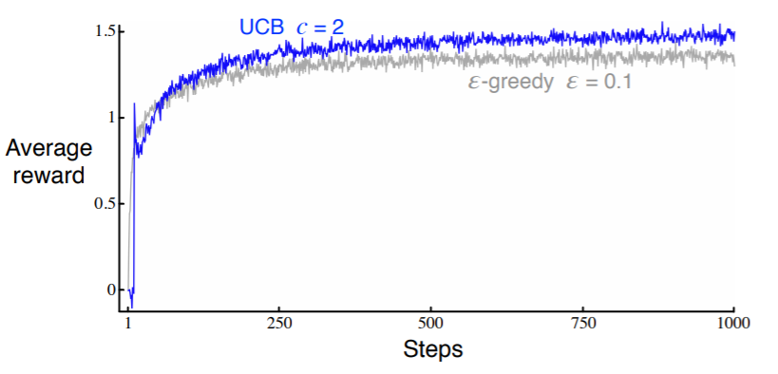
Upper Confidence Bounds (UCB)
INTRODUCTION TO COMPUTING
Course Code: CCINCOM/L
Review in Probability, Intro to RL Concepts
Average performance of UCB action selection on the 10-armed testbed. As shown, UCB generally performs better than ε-greedy action selection, except in the first k steps, when it selects randomly among the as-yet-untried actions.
Joseph Marvin R. Imperial
REINFORCEMENT LEARNING
NU College of Computing and Information Technologies
Course Code: CCRNFLRL

Slide 37
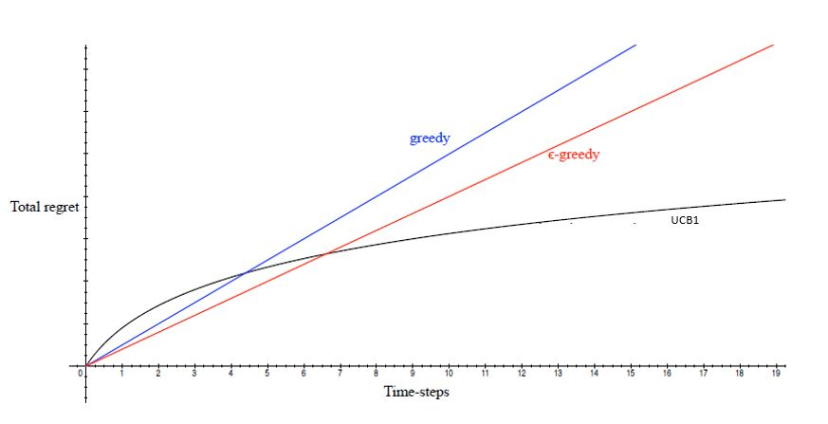
Regret Comparison
INTRODUCTION TO COMPUTING
Course Code: CCINCOM/L
Review in Probability, Intro to RL Concepts
Joseph Marvin R. Imperial
REINFORCEMENT LEARNING
NU College of Computing and Information Technologies
Course Code: CCRNFLRL

Slide 38
Implementing UCB1
INTRODUCTION TO COMPUTING
Course Code: CCINCOM/L
From your code, call the UCB1 solver from the solvers.py module. Make the necessary adjustments to the code to test it.
Review in Probability, Intro to RL Concepts
Joseph Marvin R. Imperial
REINFORCEMENT LEARNING
NU College of Computing and Information Technologies
Course Code: CCRNFLRL

Slide 39
Multi-Arm Bandit Activity
INTRODUCTION TO COMPUTING
Course Code: CCINCOM/L
Open your code from last time. On a 10 multi-armed bandit, take 1000 runs of the following strategies each with 2000 timesteps while saving the total cumulative reward and total cumulative regret.
ε = 0
ε = 0.1
ε = 0.01
UCB
Visualize the performances of each strategy in a graph. A total of two graphs should be made: one showing the total reward and one for total regret. Make sure to fix your labels.
Hint: Look at self.regret in code.
Joseph Marvin R. Imperial
REINFORCEMENT LEARNING
NU College of Computing and Information Technologies
Course Code: CCRNFLRL

Slide 40
Multi-Arm Bandit Activity
INTRODUCTION TO COMPUTING
Course Code: CCINCOM/L
Joseph Marvin R. Imperial
REINFORCEMENT LEARNING
NU College of Computing and Information Technologies
Course Code: CCRNFLRL

Slide 41
Thompson Sampling
INTRODUCTION TO COMPUTING
Course Code: CCINCOM/L
Epsilon and UCB have selected their actions based on the current averages of the rewards received from those actions.
For Thompson Sampling, rather than just refining an estimate of the mean reward, it extends this to instead build up a probability model from the obtained rewards, and then samples from this to choose an action.
Review in Probability, Intro to RL Concepts
Joseph Marvin R. Imperial
REINFORCEMENT LEARNING
NU College of Computing and Information Technologies
Course Code: CCRNFLRL

Slide 42
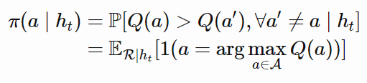

Thompson Sampling
INTRODUCTION TO COMPUTING
Course Code: CCINCOM/L
At each time step, we want to select action $a$ according to the probability that $a$ is optimal (probability matching).
where $π(a|ht)$is the probability of taking action a given the history $ht$.
Review in Probability, Intro to RL Concepts
Joseph Marvin R. Imperial
REINFORCEMENT LEARNING
NU College of Computing and Information Technologies
Course Code: CCRNFLRL

Slide 43
Thompson Sampling Steps
INTRODUCTION TO COMPUTING
Course Code: CCINCOM/L
To begin with, all machines are assumed to have a uniform distribution of the probability of success, in this case getting a reward.
For each observation obtained from a slot machine, based on the reward a new distribution is generated with probabilities of success for each slot machine.
Further observations are made based on these prior probabilities obtained on each round or observation which then updates the success distributions.
After sufficient observations, each slot machine will have a success distribution associated with it which can help the player in choosing the machines wisely to get the maximum rewards.
Review in Probability, Intro to RL Concepts
Joseph Marvin R. Imperial
REINFORCEMENT LEARNING
NU College of Computing and Information Technologies
Course Code: CCRNFLRL

Slide 44
References
INTRODUCTION TO COMPUTING
Course Code: CCINCOM/L
Images are licensed with Creative Commons. Can use without citing.
Prof. Emma Brunskill’s slides (CS234RL). https://web.stanford.edu/class/cs234/slides/lecture1.pdf
David Silver’s slides. https://www.davidsilver.uk/wp-content/uploads/2020/03/intro_RL.pdf
Review in Probability, Intro to RL Concepts
Joseph Marvin R. Imperial
REINFORCEMENT LEARNING
NU College of Computing and Information Technologies
Course Code: CCRNFLRL

